Slide 1


Existence
of GOD
WORLD VIEWS
THEISM : BELIEVES IN EXISTENCE OF GOD.
ATHEISM: NOT BELIEVES IN EXISTENCE OF GOD.
OMNIPOTENT: EVERYTHING IS POSSIBLE, LOGICALLY IMPOSSIBLE (DESCARTE)
OMNISCIENT: KNOWS EVERYTHING.

Slide 2
Existence
of GOD
WORLD VIEWS
THEISM : BELIEVES IN EXISTENCE OF GOD.
ATHEISM: NOT BELIEVES IN EXISTENCE OF GOD.
OMNIPOTENT: EVERYTHING IS POSSIBLE, LOGICALLY IMPOSSIBLE (DESCARTE)
OMNISCIENT: KNOWS EVERYTHING.
The Design Argument
THE SIMPLEST, MOST STRAIGHTFORWARD ARGUMENT FOR THE EXISTENCE OF GOD
CAN BE STATED IN A FEW, EASY-TO-UNDERSTAND STEPS.
SOMETIMES CALLED AS THE TELEOLOGICAL ARGUMENT
THE MOST INFLUENTIAL ARGUMENT FOR THE EXISTENCE OF GOD THROUGHOUT MOST OF HISTORY
IF WE PAY CLOSE ATTENTION TO THE DETAILS OF THE UNIVERSE IN WHICH WE LIVE, WE'LL BE ABLE TO SEE THAT UNIVERSE MUST HAVE BEEN CREATED BY AN INTELLIGENT DESIGNER.
THE FACT THAT EVERYTHING IN NATURE SEEMS TO BE PUT TOGETHER IN JUST THE RIGHT MANNER SUGGESTS THAT AN INTELLIGENT DESIGNER WAS RESPONSIBLE FOR ITS CREATION.

Slide 3

WORLD VIEWS
THEISM : BELIEVES IN EXISTENCE OF GOD.
ATHEISM: NOT BELIEVES IN EXISTENCE OF GOD.
OMNIPOTENT: EVERYTHING IS POSSIBLE, LOGICALLY IMPOSSIBLE (DESCARTE)
OMNISCIENT: KNOWS EVERYTHING.
The Design (Teleological) Argument
This goes with the Origin of Life section, and the First Cause Argument goes with the Origin of the universe section.
Set out originally by William Paley in 1802 in a book called Natural Theology.
It is an a posteriori argument (meaning it is based on sense experience).
It is called the Teleological Argument because of the Greek word telos, meaning design or purpose.
It is based on the observation of the variety, order and beauty in the universe, which presupposes design and purpose in its’ creation.
Paley's Teleological Argument
PREMISES:
HUMAN ARTIFACTS ARE PRODUCTS OF INTELLIGENT DESIGN. THEY HAVE A PURPOSE
THE UNIVERSE RESEMBLES HUMAN ARTIFACTS.
THEREFORE THE UNIVERSE IS A PRODUCT OF INTELLIGENT DESIGN AND HAS A PURPOSE
BUT THE UNIVERSE IS COMPLEX AND GIGANTIC, IN COMPARISON TO HUMAN ARTIFACTS.
DAVID HUME, 1711-1776, ARGUED AGAINST THE DESIGN ARGUMENT THROUGH AN EXAMINATION OF THE NATURE OF ANALOGY.
THEREFORE, THERE PROBABLY IS A POWERFUL AND VASTLY INTELLIGENT DESIGNER WHO CREATED THE UNIVERSE.

Slide 4
The Design Argument
THE SIMPLEST, MOST STRAIGHTFORWARD ARGUMENT FOR THE EXISTENCE OF GOD
CAN BE STATED IN A FEW, EASY-TO-UNDERSTAND STEPS.
SOMETIMES CALLED AS THE TELEOLOGICAL ARGUMENT
THE MOST INFLUENTIAL ARGUMENT FOR THE EXISTENCE OF GOD THROUGHOUT MOST OF HISTORY
IF WE PAY CLOSE ATTENTION TO THE DETAILS OF THE UNIVERSE IN WHICH WE LIVE, WE'LL BE ABLE TO SEE THAT UNIVERSE MUST HAVE BEEN CREATED BY AN INTELLIGENT DESIGNER.
THE FACT THAT EVERYTHING IN NATURE SEEMS TO BE PUT TOGETHER IN JUST THE RIGHT MANNER SUGGESTS THAT AN INTELLIGENT DESIGNER WAS RESPONSIBLE FOR ITS CREATION.
Traditional Criticisms of the Design Argument
These criticisms come mainly from David Hume’s book Dialogues Concerning Natural Religion (1801 – BEFORE Paley published his book!).
His first argument that any analogical argument is weak – to say something is LIKE something else, is not proof.
If the universe was designed, it is not necessarily by God (the watch, for example, could have been designed by a team, or by a genius lunatic, etc so these possibilities should also apply to god).
The universe is NOT like a watch! (One is mechanical and ‘set’, the other is organic, changing and growing).
Nature is NOT perfect, beautiful and harmonious. There is just as much chaos and disorder as order and beauty (disease, disaster, war, etc) – either the designer is poor, or perverse!
If there is design in nature, nature may be providing it ‘herself’: “For all we know a priori, matter may contain the source or spring of order naturally within itself.”
[Some people argue that Hume’s criticisms of the argument are so infallible, that Paley would not have published his book if he had known about them!]

Slide 5


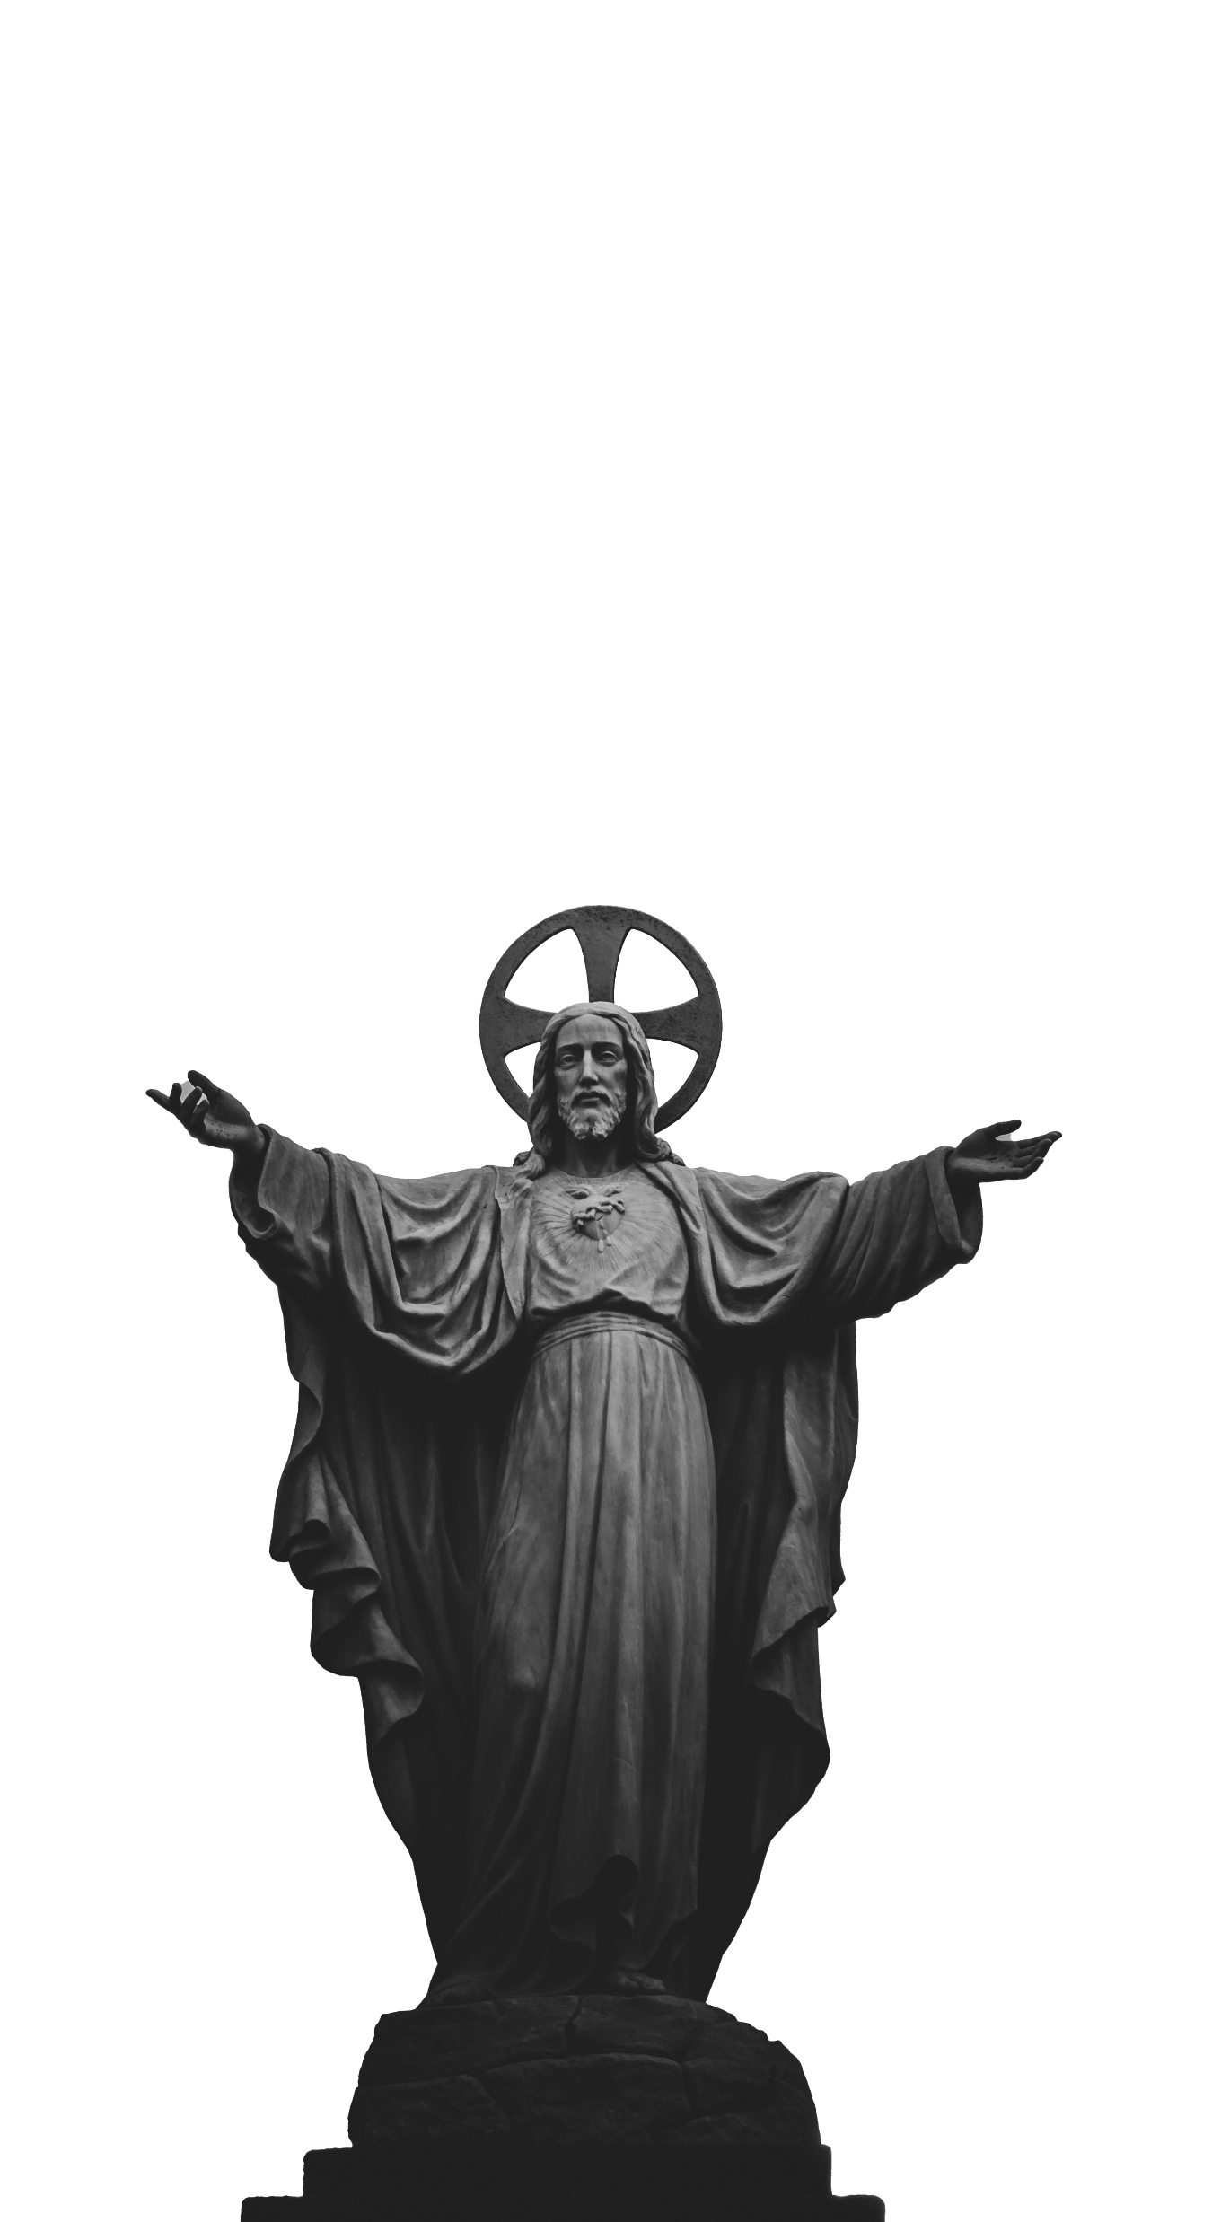
Ontology?
BRANCH OF METAPHYSICS THAT STUDIES THE NATURE OF EXISTENCE OR BEING AS SUCH; METAPHYSICAL
Ontological argument?
THE ARGUMENT THAT GOD, BEING DEFINED AS MOST GREAT OR PERFECT, MUST EXIST

Slide 6

Ontology?
BRANCH OF METAPHYSICS THAT STUDIES THE NATURE OF EXISTENCE OR BEING AS SUCH; METAPHYSICAL
Ontological argument?
THE ARGUMENT THAT GOD, BEING DEFINED AS MOST GREAT OR PERFECT, MUST EXIST

Slide 7
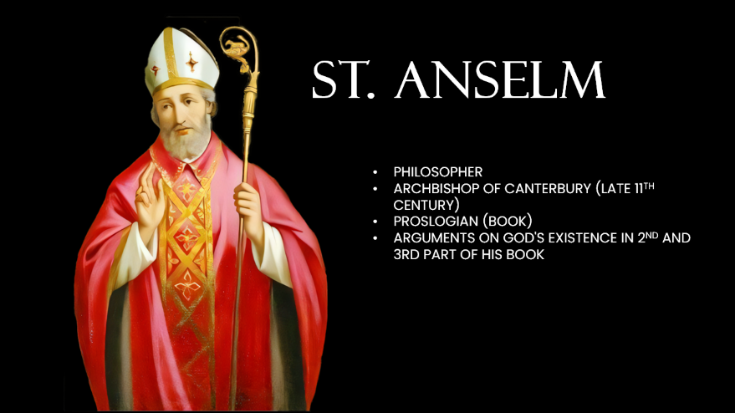
PHILOSOPHER
ARCHBISHOP OF CANTERBURY (LATE 11TH CENTURY)
PROSLOGIAN (BOOK)
ARGUMENTS ON GOD'S EXISTENCE IN 2ND AND 3RD PART OF HIS BOOK
Ontology?
BRANCH OF METAPHYSICS THAT STUDIES THE NATURE OF EXISTENCE OR BEING AS SUCH; METAPHYSICAL
Ontological argument?
THE ARGUMENT THAT GOD, BEING DEFINED AS MOST GREAT OR PERFECT, MUST EXIST

Slide 8
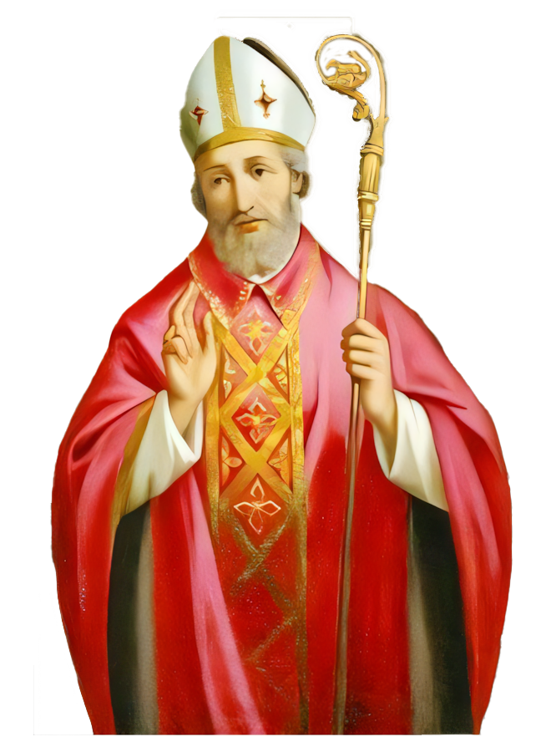
St. Anselm
PHILOSOPHER
ARCHBISHOP OF CANTERBURY (LATE 11TH CENTURY)
PROSLOGIAN (BOOK)
ARGUMENTS ON GOD'S EXISTENCE IN 2ND AND 3RD PART OF HIS BOOK

Slide 9
St. Anselm
PHILOSOPHER
ARCHBISHOP OF CANTERBURY (LATE 11TH CENTURY)
PROSLOGIAN (BOOK)
ARGUMENTS ON GOD'S EXISTENCE IN 2ND AND 3RD PART OF HIS BOOK

Slide 10
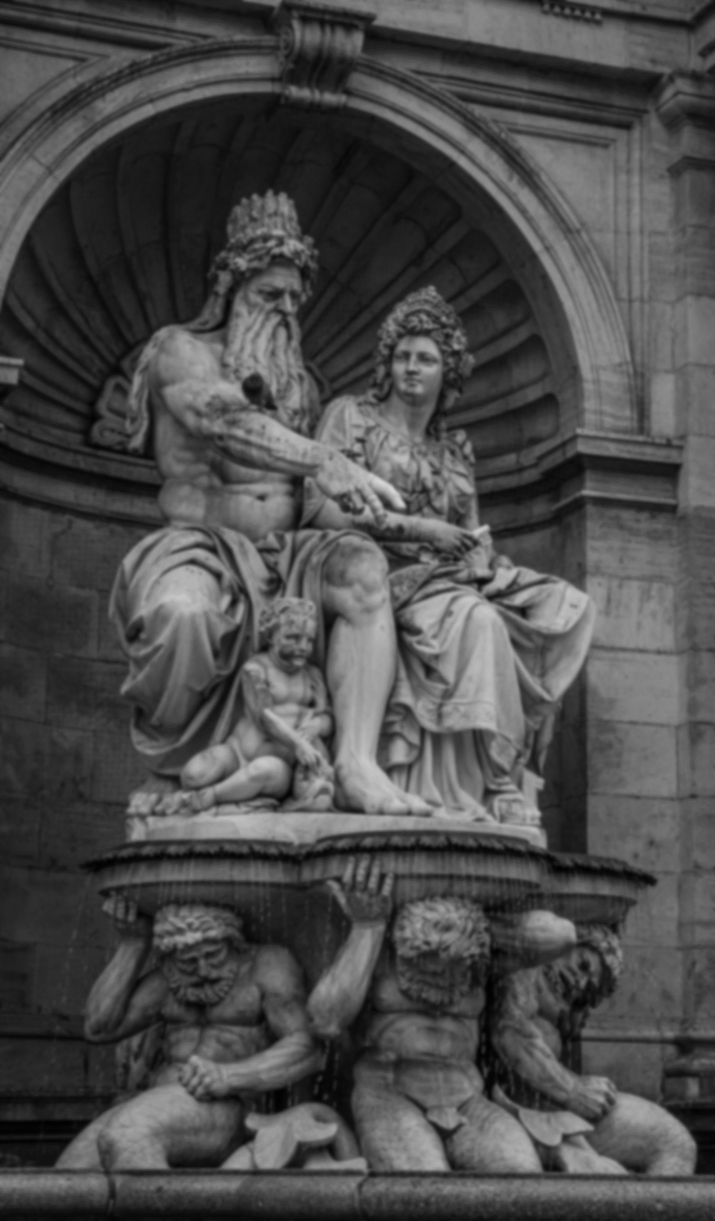
The Ontological Argument
The ontological argument is a fascinating philosophical attempt to prove the existence of God through pure reason, rather than empirical evidence or experience. It's a purely conceptual argument, focusing on the idea of God itself.
ANSELM'S FORMULATION
The most famous version of the ontological argument comes from St. Anselm of Canterbury. He defined God as "that than which nothing greater can be conceived." This means God is the greatest possible being imaginable.

Slide 11
Anselm then argued:
God is defined as the greatest conceivable being.
A being that exists in reality is greater than a being that exists only in the mind.
If God exists only in the mind, then we can conceive of a greater being (one that exists in reality).
But God is defined as the greatest conceivable being.
Therefore, God must exist in reality.
Essentially, Anselm concludes that if God is the greatest possible being, then existence is a necessary attribute of God. To imagine God without existence is to imagine something greater than God, which is a contradiction.

Slide 12
Criticisms and Variations
The ontological argument has been subjected to intense scrutiny and criticism. Some of the main objections include:
Existence is not a predicate: Critics argue that existence is not a property or attribute like being tall or blue. Therefore, it cannot be part of a definition.
Conceptual vs. Real: Just because we can conceive of something doesn't mean it exists in reality. For example, we can conceive of a perfect unicorn, but that doesn't mean it exists.
Circular reasoning: Some argue that Anselm's argument is circular, as it assumes God's existence in the definition of God.
Despite these criticisms, the ontological argument continues to be a subject of philosophical debate. It offers a unique approach to the question of God's existence, even if it's not universally accepted.

Slide 13

The Moral Argument
The moral argument posits that the existence of objective moral values and duties necessitates the existence of God as their ultimate ground or source. In essence, it argues that without a divine being to establish moral law, there can be no basis for morality.
Core Premises:
Objective Moral Values and Duties Exist: There are universal moral principles that transcend cultural and individual preferences.
These Moral Values and Duties Require a Ground: To have true meaning and authority, moral values and duties must be grounded in something beyond human opinion or societal constructs.
God is the Best Explanation: The most plausible explanation for the existence of objective moral values and duties is a divine being who is the source of moral law.

Slide 14
Criticisms
The moral argument is not without its challenges:
Is Morality Objective?: Some philosophers argue that morality is subjective or culturally constructed, undermining the premise of objective moral values.
Other Groundings: Critics suggest that morality can be grounded in human nature, reason, or evolution without invoking God.
Is God Moral?: Even if God is the source of morality, it doesn't necessarily mean God is good. The problem of evil challenges the idea of a perfectly good God.
Despite these criticisms, the moral argument remains a significant point of discussion in the philosophy of religion. It offers a compelling perspective on the relationship between morality and divinity.

Slide 15

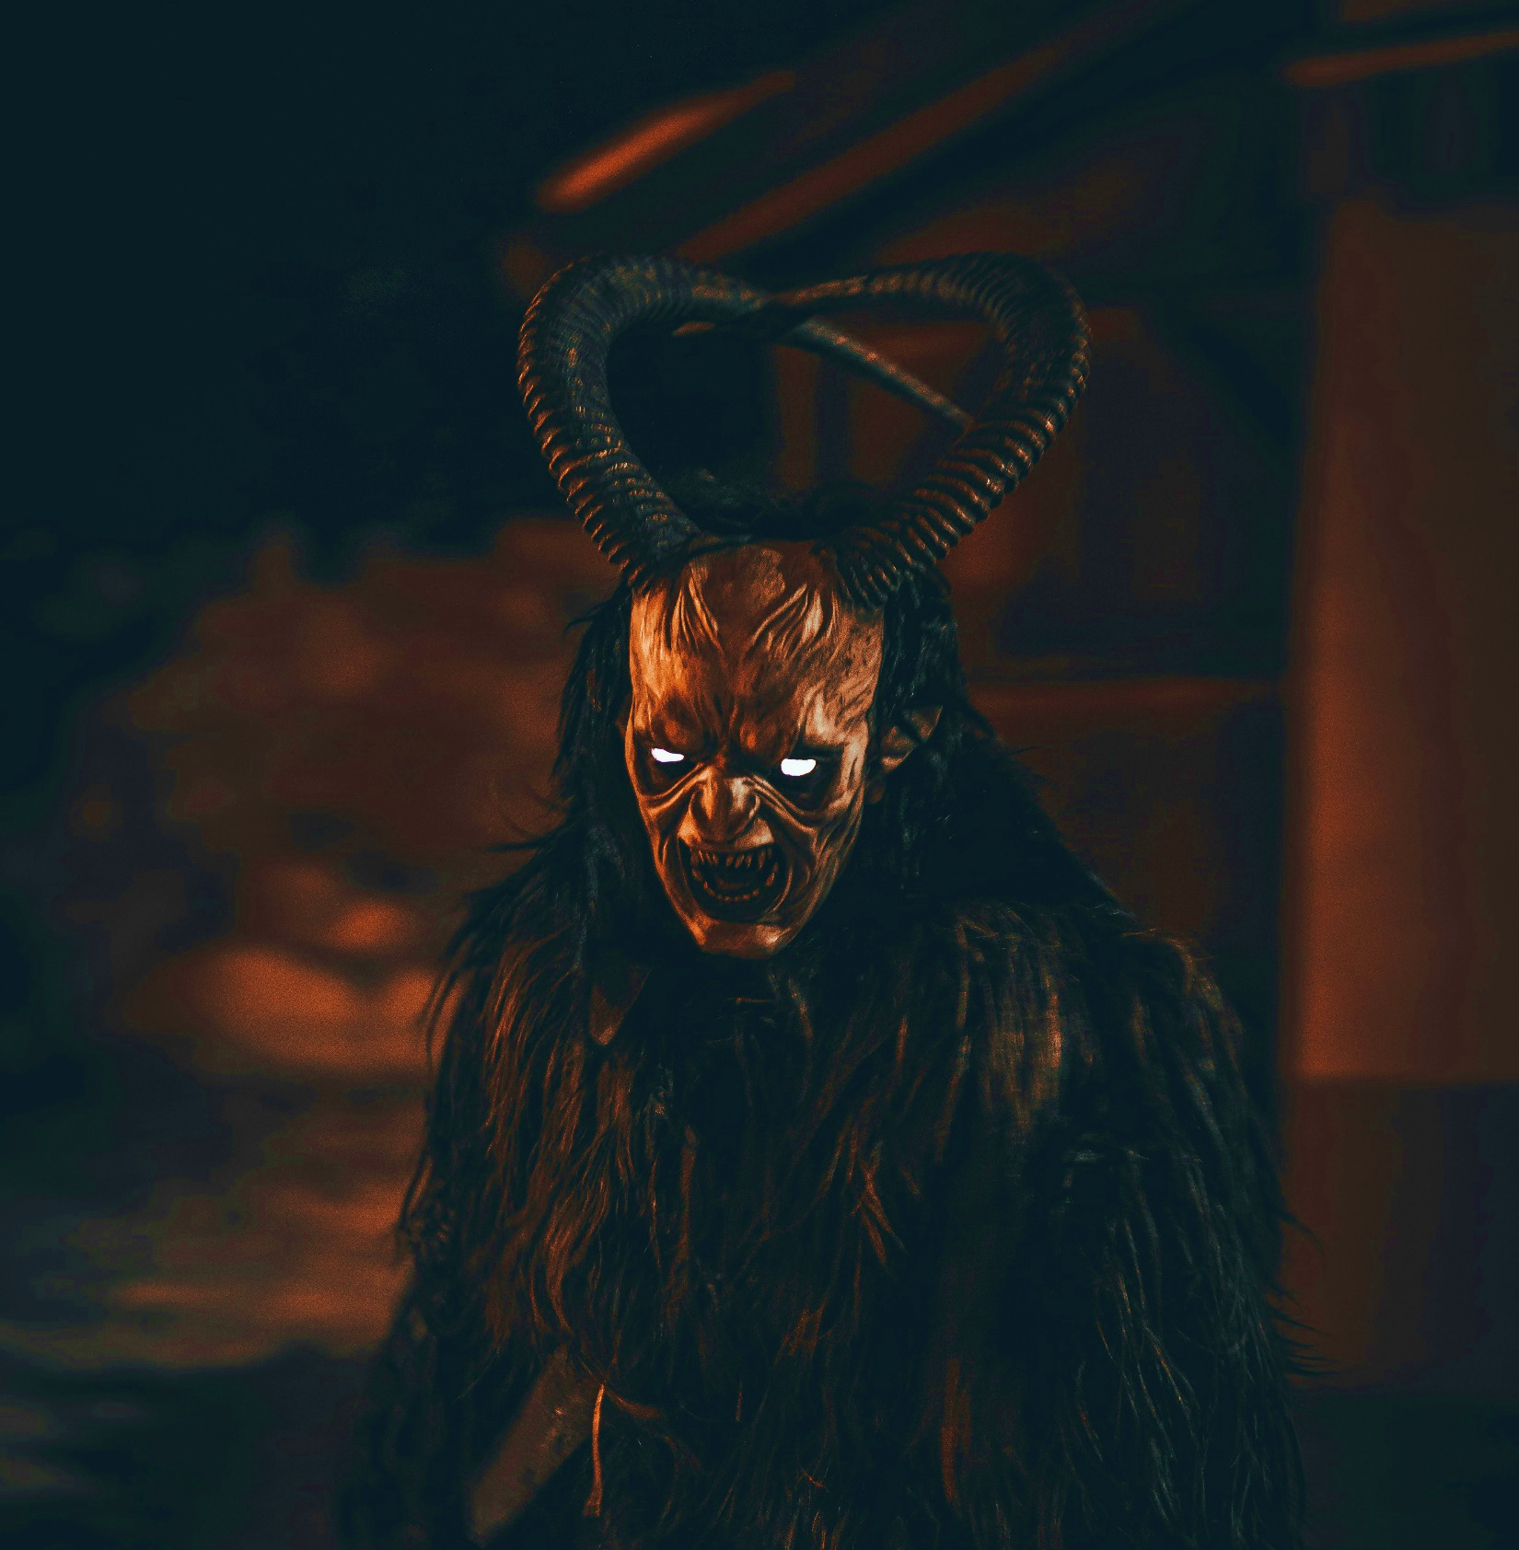
Arguments against the existence of God
The Problem of Evil
Problem of evil: This argument points to the existence of evil and suffering in the world, and argues that it is incompatible with the existence of an all-powerful, all-good, and all-knowing God.
Lack of evidence: Critics of the existence of God argue that there is no scientific evidence to support the claim that God exists, and that belief in God is based on faith rather than reason.
Inconsistent revelations: Different religions offer different and often contradictory accounts of God, which suggests that there is no single, true understanding of God.
Human-created concept: Some argue that the concept of God is a human creation, developed as a way to explain the world and provide comfort in the face of uncertainty.

Slide 16
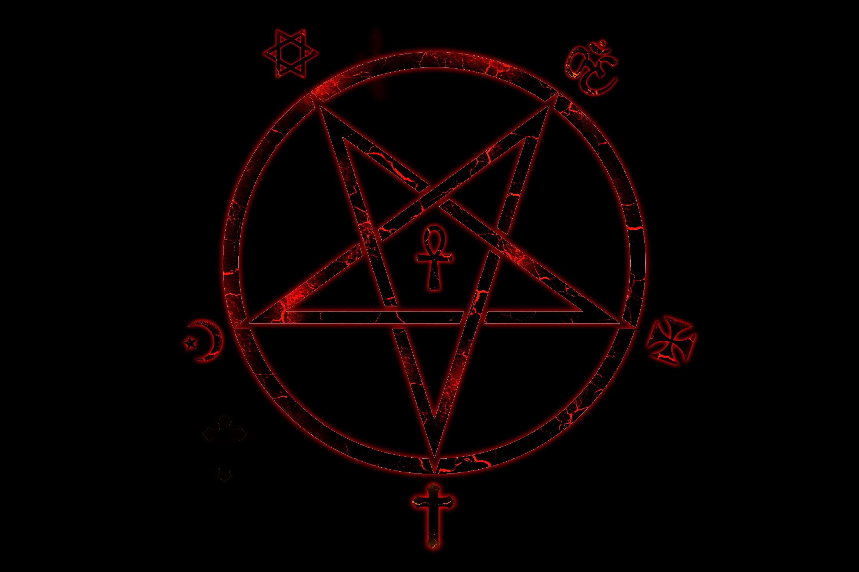
Arguments against the existence of God
The Problem of Evil
Problem of evil: This argument points to the existence of evil and suffering in the world, and argues that it is incompatible with the existence of an all-powerful, all-good, and all-knowing God.
Lack of evidence: Critics of the existence of God argue that there is no scientific evidence to support the claim that God exists, and that belief in God is based on faith rather than reason.
Inconsistent revelations: Different religions offer different and often contradictory accounts of God, which suggests that there is no single, true understanding of God.
Human-created concept: Some argue that the concept of God is a human creation, developed as a way to explain the world and provide comfort in the face of uncertainty.
The problem of evil is a longstanding philosophical and theological question that challenges the compatibility of the existence of an omnipotent, omnibenevolent, and omniscient God with the existence of evil and suffering in the world.
This apparent contradiction has been used as an argument against the existence of God.

Slide 17

The Problem of Evil
The problem of evil is a longstanding philosophical and theological question that challenges the compatibility of the existence of an omnipotent, omnibenevolent, and omniscient God with the existence of evil and suffering in the world.
This apparent contradiction has been used as an argument against the existence of God.
Types of Evil
NATURAL EVIL
Evil caused by natural processes, such as earthquakes, diseases, and famine.

Slide 18

Types of Evil
MORAL EVIL
Evil caused by human actions, such as murder, theft, and cruelty.
Types of Evil
The Problem of Evil
The problem of evil is a longstanding philosophical and theological question that challenges the compatibility of the existence of an omnipotent, omnibenevolent, and omniscient God with the existence of evil and suffering in the world.
NATURAL EVIL
Evil caused by natural processes, such as earthquakes, diseases, and famine.
This apparent contradiction has been used as an argument against the existence of God.

Slide 19

Types of Evil
NATURAL EVIL
Evil caused by natural processes, such as earthquakes, diseases, and famine.
Types of Evil
MORAL EVIL
Evil caused by human actions, such as murder, theft, and cruelty.

Slide 20

Types of Evil
Theodicies
Theodicies are attempts to reconcile the existence of evil with the belief in a good and omnipotent God. Some common theodicies include:
Free Will Defense: This argues that God granted humans free will, and evil is a consequence of human choices.
Soul-Making Theodicy: This proposes that suffering is necessary for moral and spiritual growth.
Greater Good Theodicy: This suggests that evil is a necessary part of a greater good, which we may not fully understand.
MORAL EVIL
Evil caused by human actions, such as murder, theft, and cruelty.

Slide 21

Types of Evil
Challenges to Theodicies
Critics argue that these theodicies are insufficient to explain the extent and nature of evil in the world. For example:
Innocent Suffering: Many innocent people suffer, which seems incompatible with a benevolent God.
Degree of Evil: The amount of suffering in the world seems disproportionate to any potential good that might come from it.
Alternative Explanations: Naturalistic explanations for evil, such as evolution and natural selection, can offer alternative perspectives.
MORAL EVIL
Evil caused by human actions, such as murder, theft, and cruelty.
The problem of evil remains a complex and challenging issue, with no easy answers. It continues to be a subject of debate among philosophers, theologians, and scientists.

Slide 22

Counterarguments
Lack of Evidence for God
It's important to note that those who believe in God often respond to the lack of evidence in various ways:
The absence of concrete, empirical evidence for the existence of God is a central point for many who question or reject religious belief. This argument often rests on the principle of Occam's Razor, which suggests that the simplest explanation is usually the correct one. Since there's no verifiable evidence for God, many conclude that the most logical explanation is that God doesn't exist.
Faith: Many argue that belief in God is based on faith, not evidence. This perspective suggests that evidence is not necessary for belief.
Nature of God: Some theists contend that God is beyond human comprehension and therefore cannot be subject to empirical verification.
Personal Experience: Many people claim to have had personal experiences that convinced them of God's existence, though these experiences are subjective and not universally verifiable.

Slide 23


Counterarguments
Lack of Evidence for God
It's important to note that those who believe in God often respond to the lack of evidence in various ways:
The absence of concrete, empirical evidence for the existence of God is a central point for many who question or reject religious belief. This argument often rests on the principle of Occam's Razor, which suggests that the simplest explanation is usually the correct one. Since there's no verifiable evidence for God, many conclude that the most logical explanation is that God doesn't exist.
Faith: Many argue that belief in God is based on faith, not evidence. This perspective suggests that evidence is not necessary for belief.
Nature of God: Some theists contend that God is beyond human comprehension and therefore cannot be subject to empirical verification.
Personal Experience: Many people claim to have had personal experiences that convinced them of God's existence, though these experiences are subjective and not universally verifiable.
God as a Human Construct
The idea that God is a human-created concept is a perspective held by many, particularly in the realms of philosophy, sociology, and anthropology. This viewpoint suggests that the concept of divinity has evolved over time as a response to human needs, fears, and desires.

Slide 24
Counterarguments
God as a Human Construct
It's important to note that those who believe in God often respond to the lack of evidence in various ways:
Faith: Many argue that belief in God is based on faith, not evidence. This perspective suggests that evidence is not necessary for belief.
Nature of God: Some theists contend that God is beyond human comprehension and therefore cannot be subject to empirical verification.
Personal Experience: Many people claim to have had personal experiences that convinced them of God's existence, though these experiences are subjective and not universally verifiable.
The idea that God is a human-created concept is a perspective held by many, particularly in the realms of philosophy, sociology, and anthropology. This viewpoint suggests that the concept of divinity has evolved over time as a response to human needs, fears, and desires.
Key Arguments
Anthropocentric Nature of God: Many gods across different cultures share striking similarities with their human creators. This suggests that humans project their own attributes, desires, and limitations onto a divine figure.
Psychological Projection: The concept of God can be seen as a psychological projection of human hopes, fears, and longings for a higher power.
Social Control: Religion, often centered around the concept of God, has historically been used as a tool for social control, reinforcing societal norms and values.
Evolutionary Origins: Some theories propose that religious beliefs, including the concept of God, evolved as a survival mechanism, providing a sense of purpose and community.

Slide 25

God as a Human Construct
The idea that God is a human-created concept is a perspective held by many, particularly in the realms of philosophy, sociology, and anthropology. This viewpoint suggests that the concept of divinity has evolved over time as a response to human needs, fears, and desires.
Key Arguments
Anthropocentric Nature of God: Many gods across different cultures share striking similarities with their human creators. This suggests that humans project their own attributes, desires, and limitations onto a divine figure.
Psychological Projection: The concept of God can be seen as a psychological projection of human hopes, fears, and longings for a higher power.
Social Control: Religion, often centered around the concept of God, has historically been used as a tool for social control, reinforcing societal norms and values.
Evolutionary Origins: Some theories propose that religious beliefs, including the concept of God, evolved as a survival mechanism, providing a sense of purpose and community.
Criticisms and Counterarguments
While the idea of God as a human construct is influential, it also faces criticism:
Subjective Nature: The claim that God is entirely a human invention is often based on subjective interpretations of religious texts, cultural practices, and human psychology.
Divine Revelation: Many religious adherents believe that the concept of God is revealed through divine inspiration or experience, rather than being solely a human creation.
Complexity of Religion: The multifaceted nature of religion, encompassing philosophical, ethical, and spiritual dimensions, makes it difficult to reduce it solely to a human construct.

Slide 26
Key Arguments
Anthropocentric Nature of God: Many gods across different cultures share striking similarities with their human creators. This suggests that humans project their own attributes, desires, and limitations onto a divine figure.
Psychological Projection: The concept of God can be seen as a psychological projection of human hopes, fears, and longings for a higher power.
Social Control: Religion, often centered around the concept of God, has historically been used as a tool for social control, reinforcing societal norms and values.
Evolutionary Origins: Some theories propose that religious beliefs, including the concept of God, evolved as a survival mechanism, providing a sense of purpose and community.
Criticisms and Counterarguments
While the idea of God as a human construct is influential, it also faces criticism:
Subjective Nature: The claim that God is entirely a human invention is often based on subjective interpretations of religious texts, cultural practices, and human psychology.
Divine Revelation: Many religious adherents believe that the concept of God is revealed through divine inspiration or experience, rather than being solely a human creation.
Complexity of Religion: The multifaceted nature of religion, encompassing philosophical, ethical, and spiritual dimensions, makes it difficult to reduce it solely to a human construct.

